Slide 1
Humanities Mapping & GIS

Slide 2
Spectrum of spatial analysis projects
Humanists are often here
Or here (depending on your perspective)
Heat map
Cost Distance Analysis
symbolized points on a map
predictive spatial analysis
info in a spreadsheet
info in a geospatial database
Notes:
Humanists are often off the spectrum because of their privileging of narrative over the spatial, which often leads to using spatial representation to augment the text rather than analyze it.

Slide 3
Not All Maps Use GIS
Maps are often used in archival and digital storytelling projects because they are useful to the discovery or presentation of the content
Mapping tools that are good for archival projects:
Omeka Geolocation or Neatline
Google My Maps
Mapping tools that are good for digital storytelling projects:
StorymapJS
Story Maps
Omeka Curatescape or Neatline

Slide 4
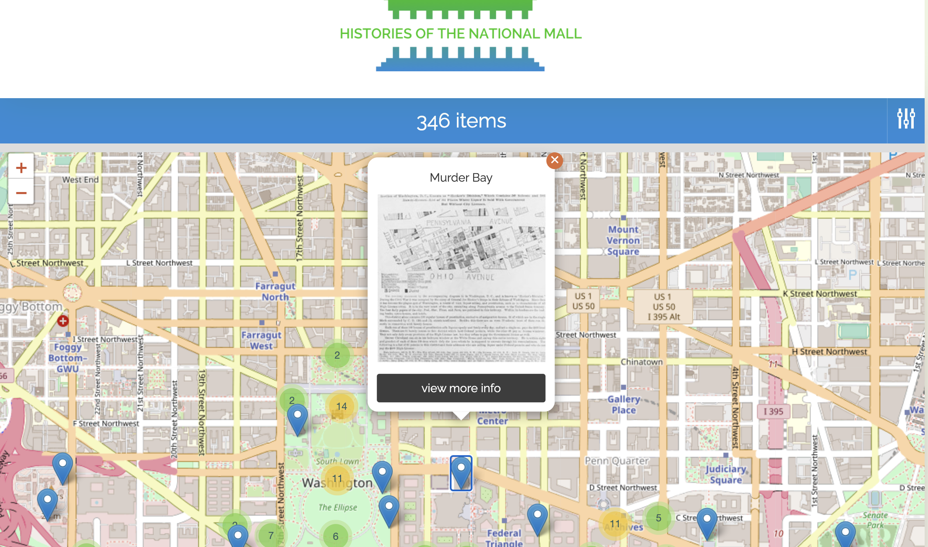
Omeka Geolocation
Notes:
In the above example, the the Roy Rosenzweig Center for History and New Media uses Omeka’s Geolocation plugin to make archival materials about the National Mall discoverable through a map.

Slide 5
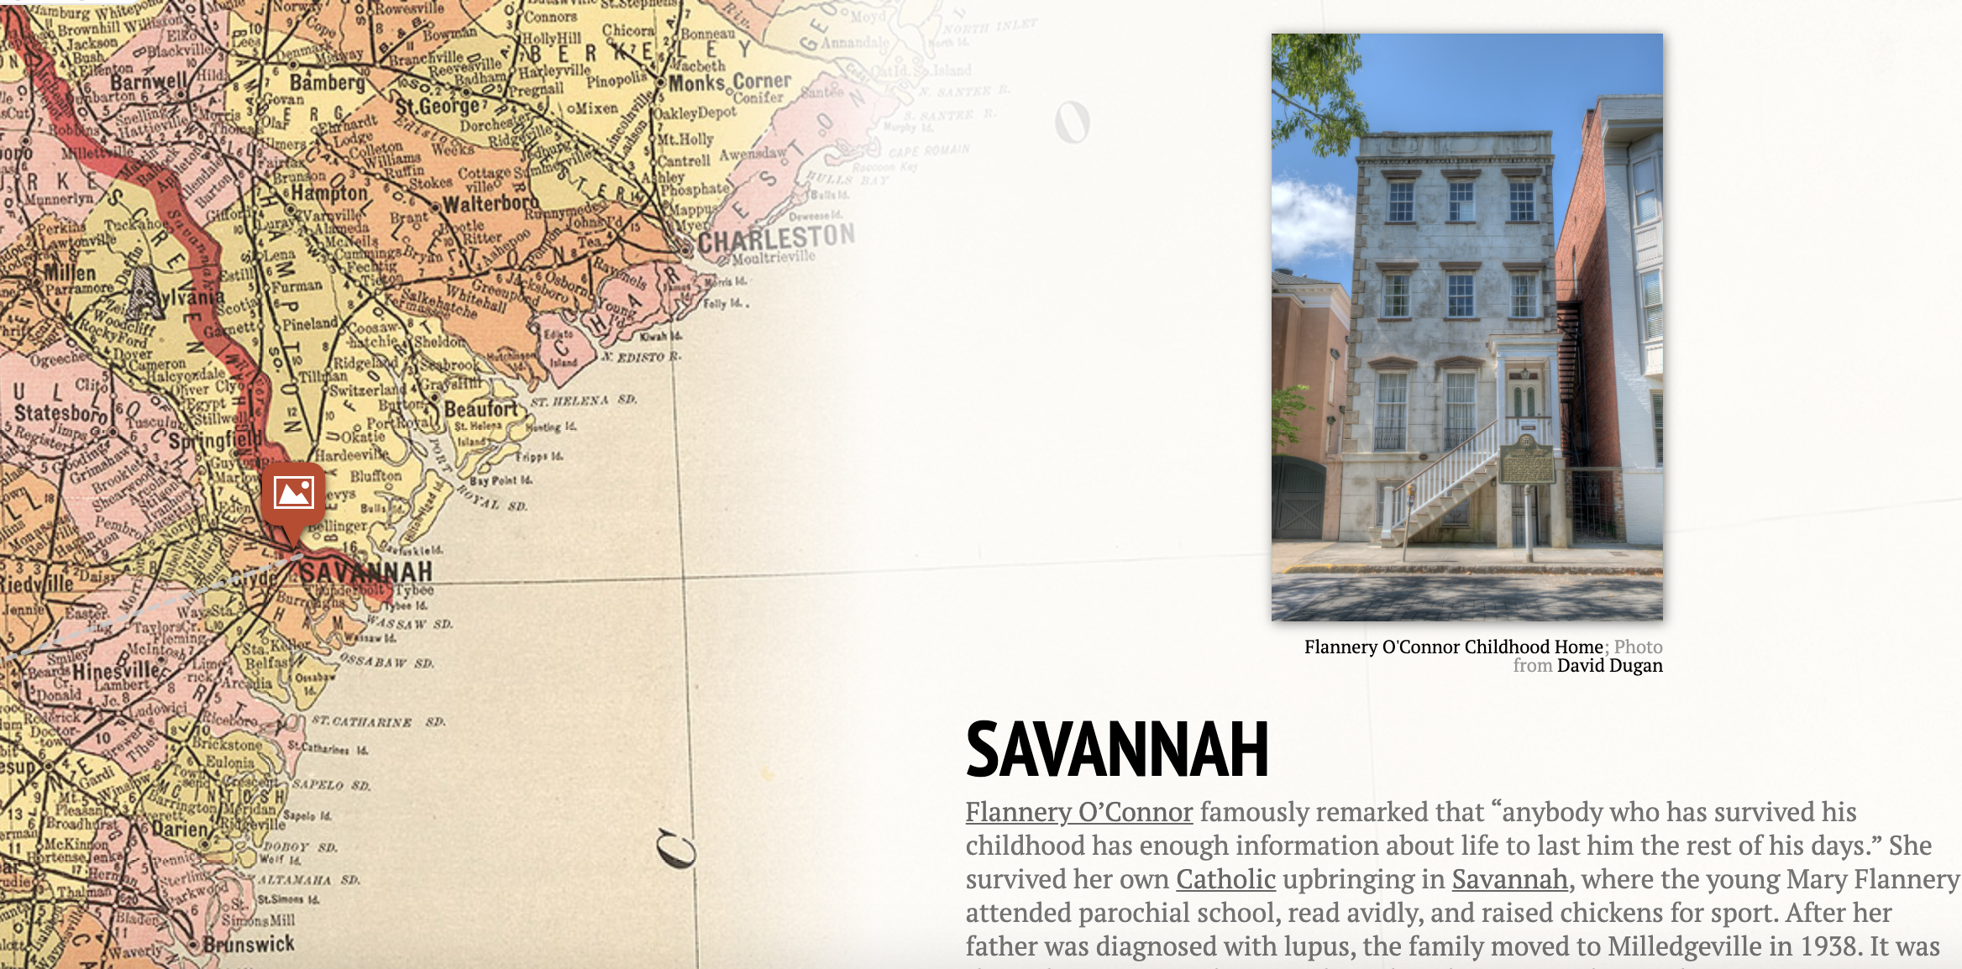
StorymapJS
Notes:
In the above example, Georgia Humanities institute uses StorymapJS to highlight the locations that were influential to southern writers. With StorymapJS you can even add a background image not a map, like the Garden of Earthly Delights.

Slide 6
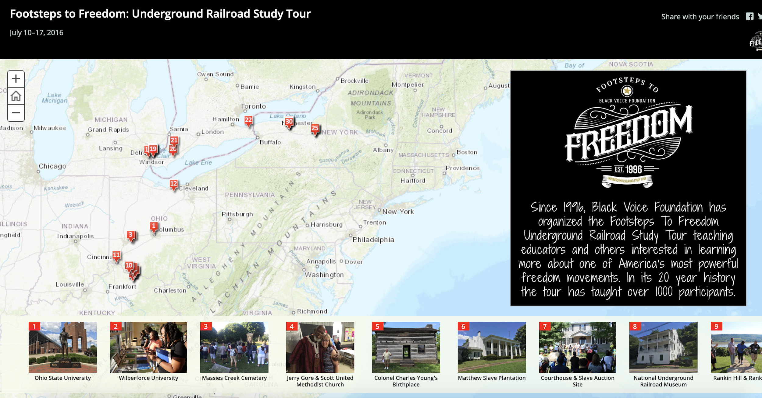
ESRI Story Maps
Notes:
ESRI’s ArcGIS Online Story Maps is another tool that is good for map-based storytelling. Above is an example of using Story Map to create a walking tour of important places celebrating and instrumental to the freedom and growth of black Americans.

Slide 7
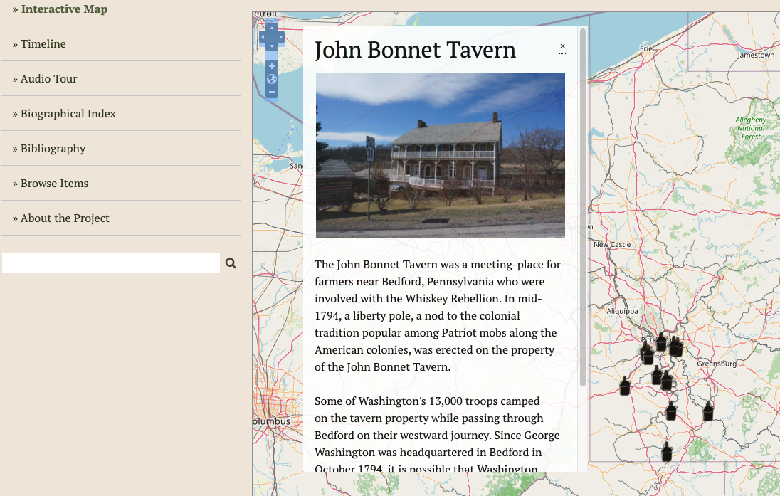
Omeka Neatline
Notes:
In the above digital project, Stephanie Krom Townrow uses Omeka’s Neatline to allow users to discover stories about important places during the Whiskey Rebellion. Neatline

Slide 8
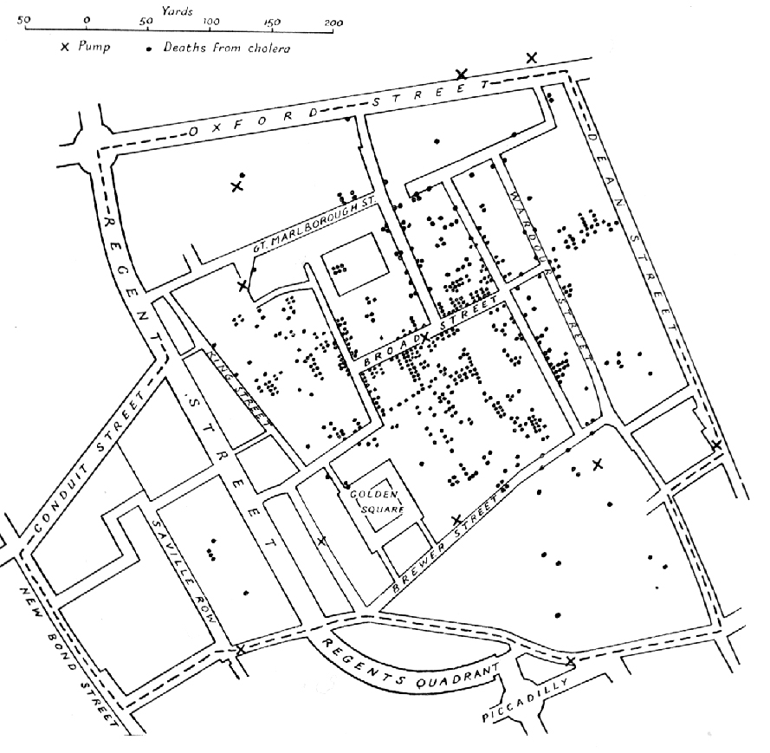
GIS in Action
When the location of objects matter to the information being shown or the argument being made.
These locations are symbolized and compared to find patterns that would be hard to recognize otherwise.
Map by Dr. John Snow of London showing clusters of cholera cases in the 1854 Broad Street cholera outbreak.
Notes:
Because geospatial analysis is not a common method in the Humanities and humanists aren’t trained in geospatial analysis, we have the harder task of determine when to use it. This starts with understanding what it is and knowing what spatial analysis looks like when you see it. John Snow’s (no not the Game of Thrones guy) visualization showed that the 1854 cholera epidemic was spread through the air but a bad water supply.

Slide 9
Key Terms in GIS
Layer - visual representation of slice of geographic data for an area (ie, roads, areas on interest on Google Maps, etc.)
Symbology - A graphic used to represent a geographic feature or group of features (the symbology is usually explained in the map legend)
Vector - geographic feature(s) on the map that represent things like places, rivers, areas of interest, etc. (3 types: points, lines, and polygons.)
Raster - represents surface data on the map, such as aerial, satelite, and elevation data, and overlaid historical maps
Shapefile - data storage format that contains vector data and symbology.

Slide 10
Where to Find Data
Shapefiles - Can be added to ArcGIS Online/Story Maps and Carto
KML - Can be added to Google My Maps
Other Vector and Raster Data

Slide 11
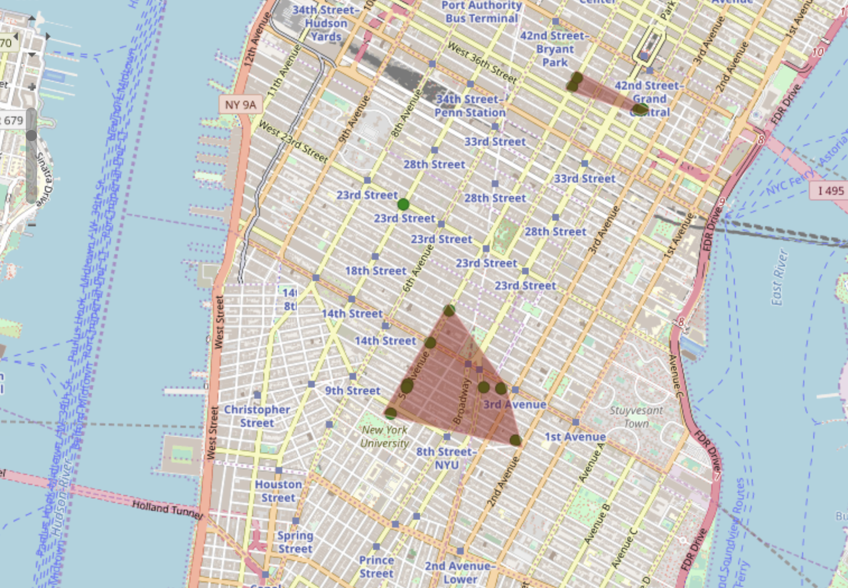
Mapping Literary Vision
Notes:
Turning points into polygon data. This map plots Newland’s movement in Edith Wharton’s Age of Innocence, then creates polygons by connecting them to highlight his movement discrepancy. One could image drawing only lines from one point to one other point to show how Newland travels during scene(s).

Slide 12
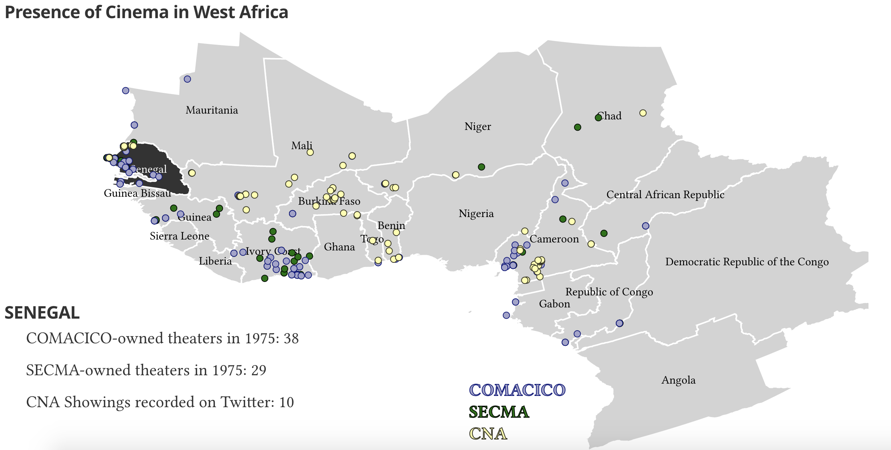
Cinema and CNA
Notes:
Turning points into density raster. The one map on the site merely plots the points of Cinema Numerique Ambulant (CNA) mobile theater showings and historical theaters in west Africa (Comacico and Secma) for comparing access to movies among countries. The other maps turns those data points into a raster layer that shows the density of CNA’s mobile showing over time in a heat map.

Slide 13
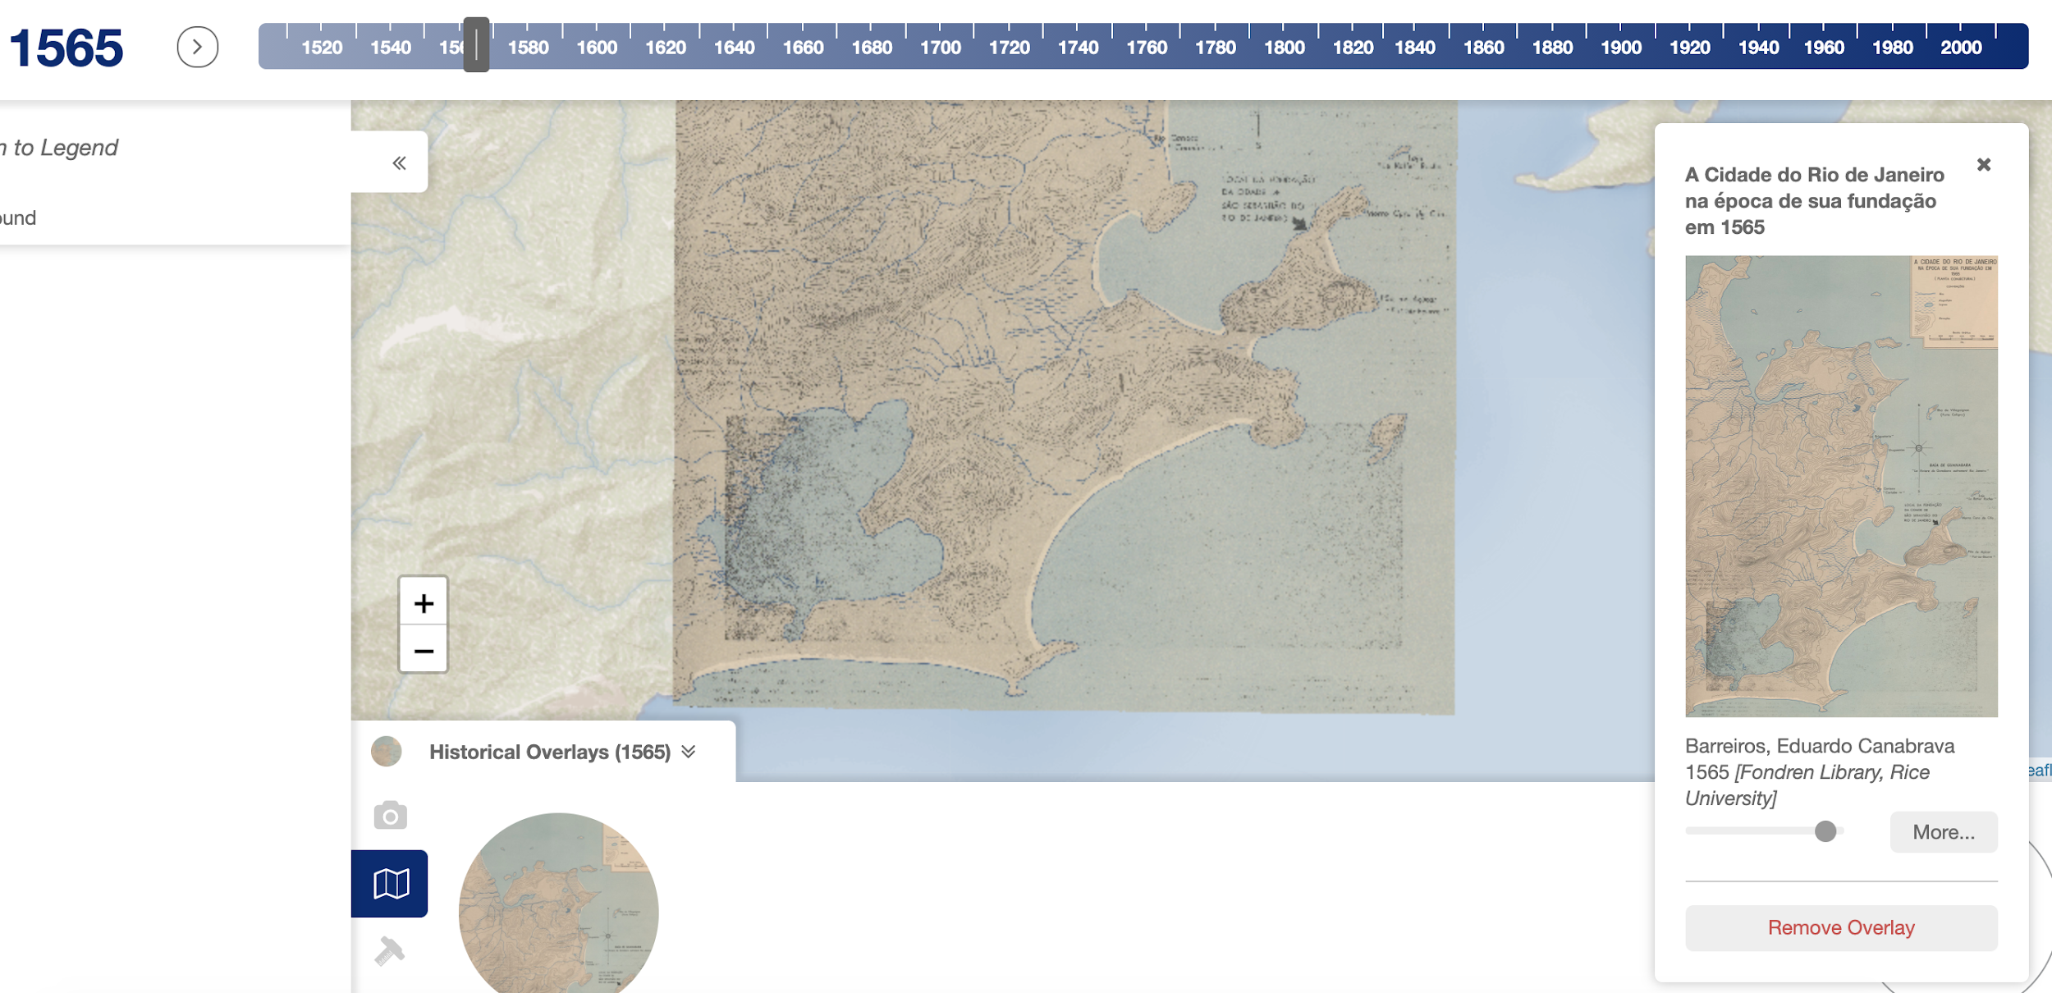
Imagine Rio
Notes:
Raster of a map of Rio from 1565 overlaid on the modern web map of Rio.

Slide 14
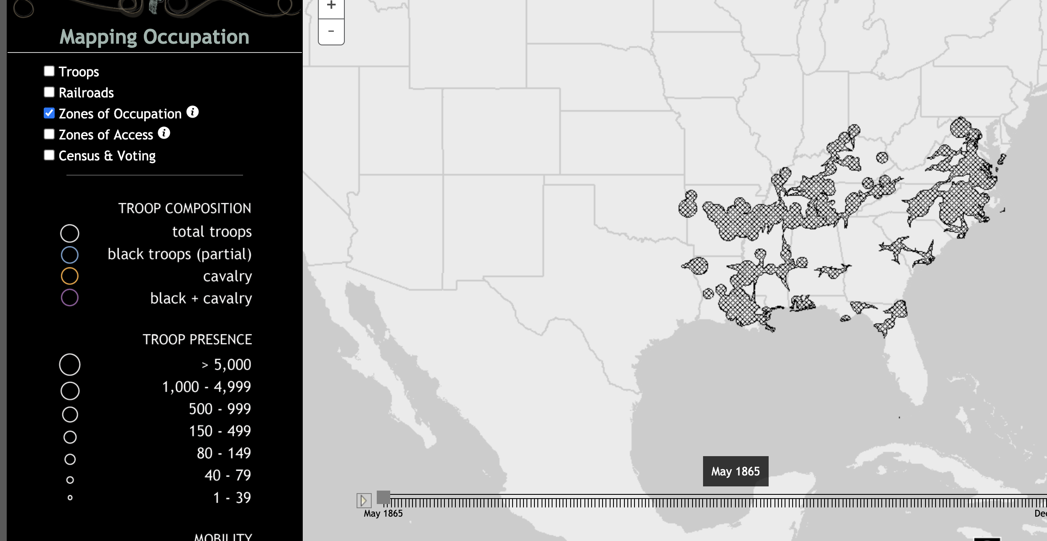
Mapping Occupation
Notes:
Click link and turn on Zones of Occupation to see raster data. Rasters are often used to do calculations in GIS software to create analysis layers like seen here. This project performs cost distance analysis to determine how much land the federal troops could control for anti-emancipation activities. The GIS calculation happens in an ArcGIS Online map that is added to the Story Map. NOTE: Institution has to licensed ArcGIS Online to do any GIS analysis.

Slide 15
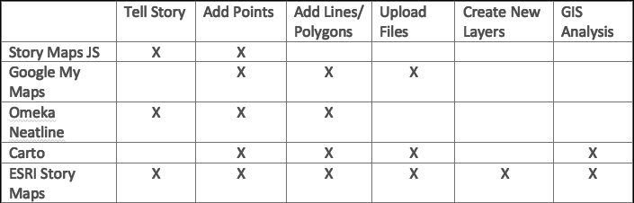
Mapping Web Tools
When choosing a tool:
Decide what features you want in the map
Start with easier tools to test feature to confirm that is what you want
X

Slide 16
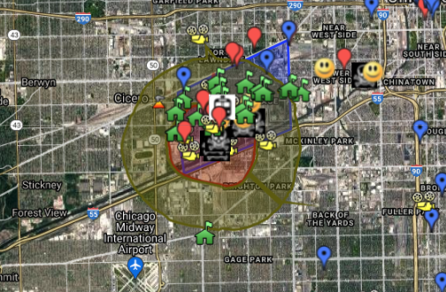
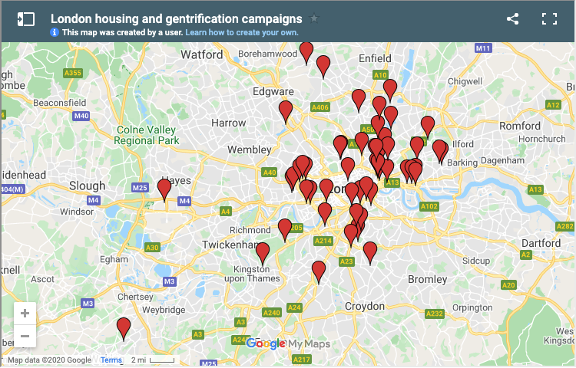
Google My Maps
Add layers of points, lines, and polygon
Join datasets in a single layer
Import existing GIS data (KML or csv)
Notes:
In the example to the left, Open Youth Networks and the Little Village Environmental Justice Organization teams up and used Google My Maps to document the toxins, dangers, and assets in Chicago’s Little Village neighborhood. This example shows how My Maps can be used to add polygons, lines, and various points and icons to individual layers to create an interactive map. In the example to the right, Action East End uses Google My Maps to visualize anti-gentrification groups in London. This example shows how easily My Maps can be embedded into sites.

Slide 17
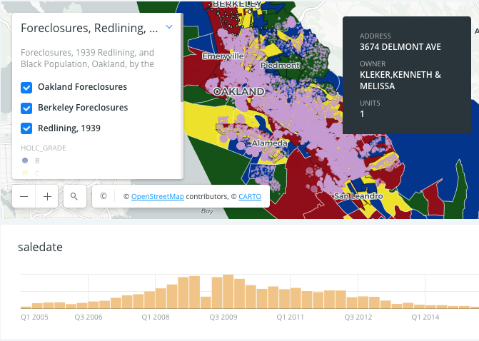
Carto
Add layers of points, lines, and polygon
Create time series maps, heat maps, and cluster maps
Join datasets in a single layer
Perform various GIS calculations
Import existing GIS data (shapefiles, csv, and geojson)
Notes:
In the above example, the Anti-Eviction Mapping Project uses Carto to create a highly interactive map of house foreclosures in Oakland and Berkeley since the early 2000s. Carto provides the ability to add points and polygons, as well as create various kinds of maps and upload many types of data.

Slide 18
ArcGIS Online/ Story Map
Add layers of points, lines, and polygon
Create time series maps, heat maps, and cluster maps
Perform various GIS calculations (subscription only)
Import existing GIS data (shapefiles, csv, and geojson)
Notes:
Story Maps allows one to embed maps made in ArcGIS Online. This project performs cost distance analysis to determine how much land the federal troops could control for anti-emancipation activities. The GIS calculation happens in an ArcGIS Online map that is added to the Story Map. NOTE: Institution has to licensed ArcGIS Online to do any GIS analysis.

Slide 19
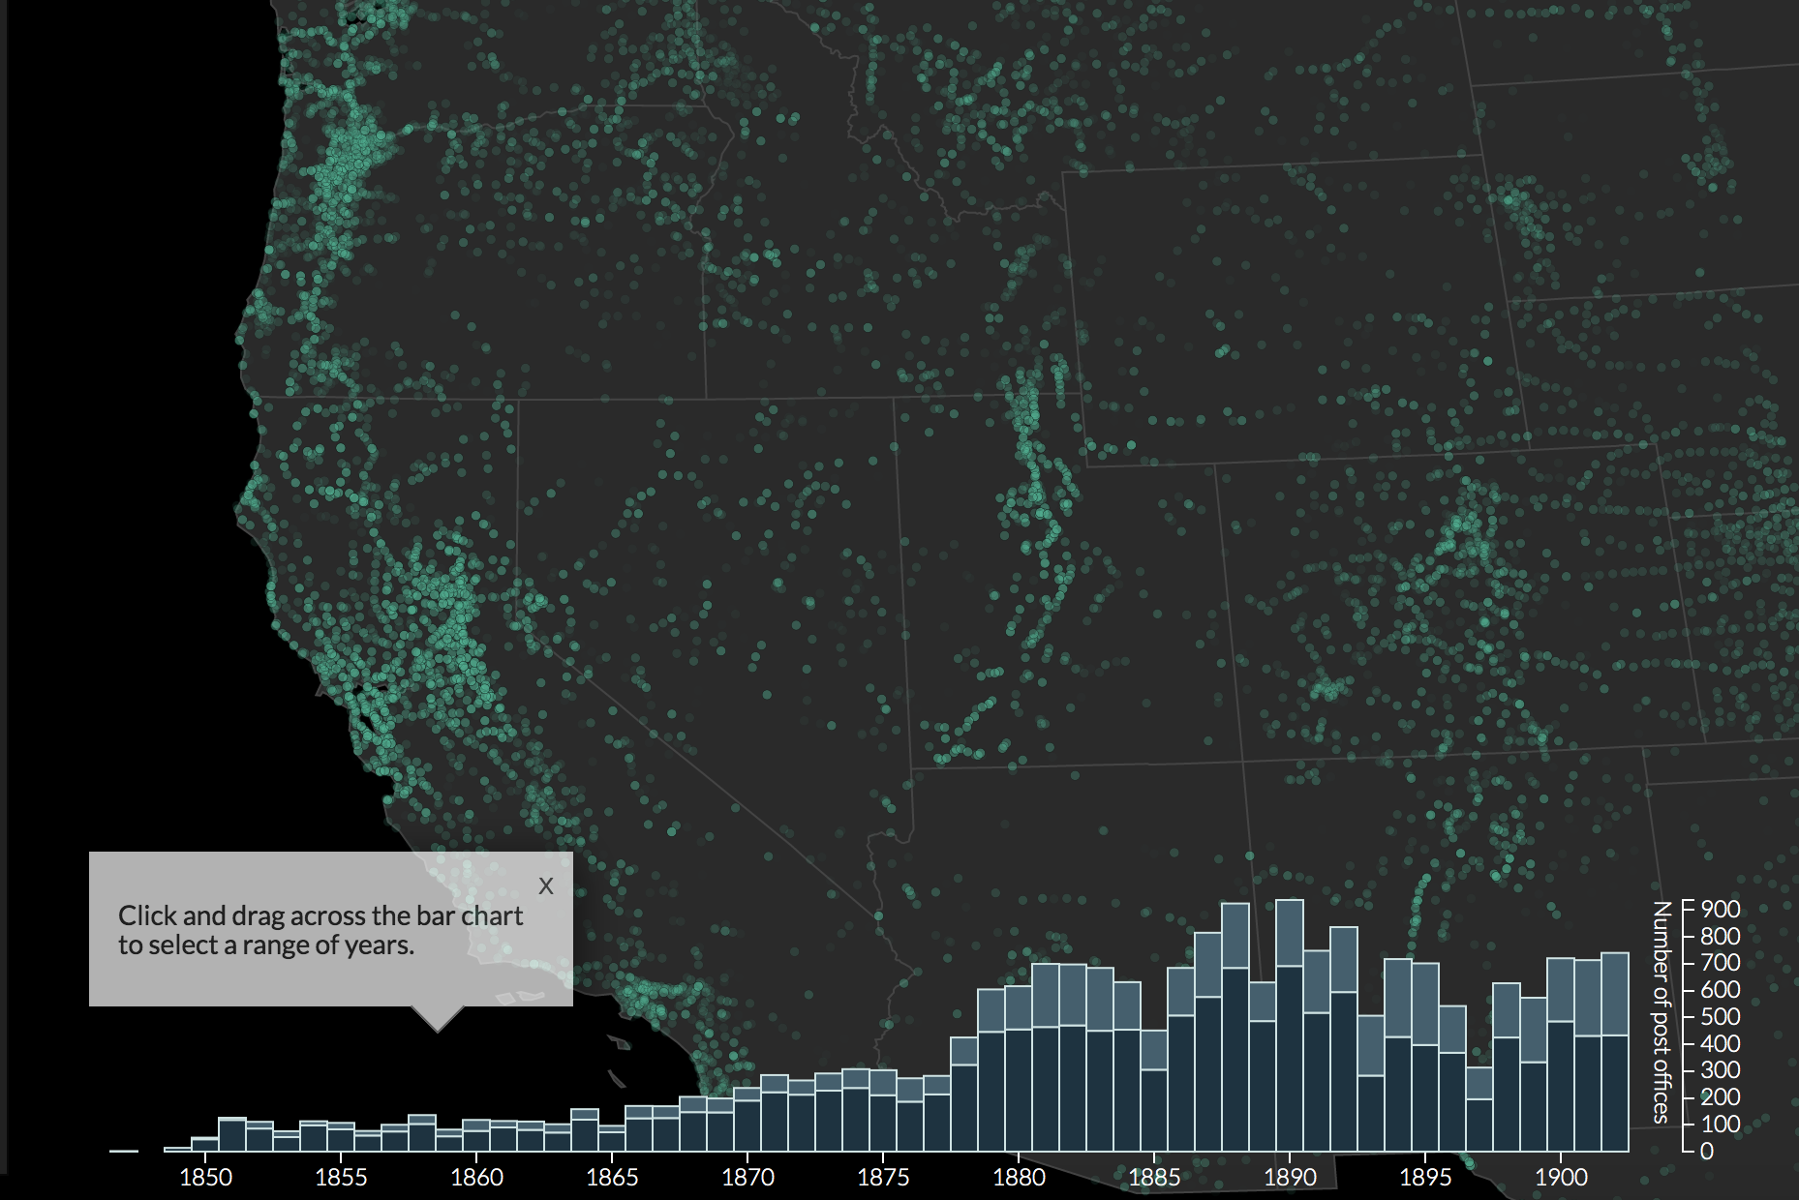
Sometimes Maps are Not Enough
Tools for mixing maps and timelines:
Omeka Neatline (using NeatlineSimile plugin)
ArcGIS Online (if institution licenses)
Carto
Top Mapping Occupation; Right: Geography of the Post.

Slide 20
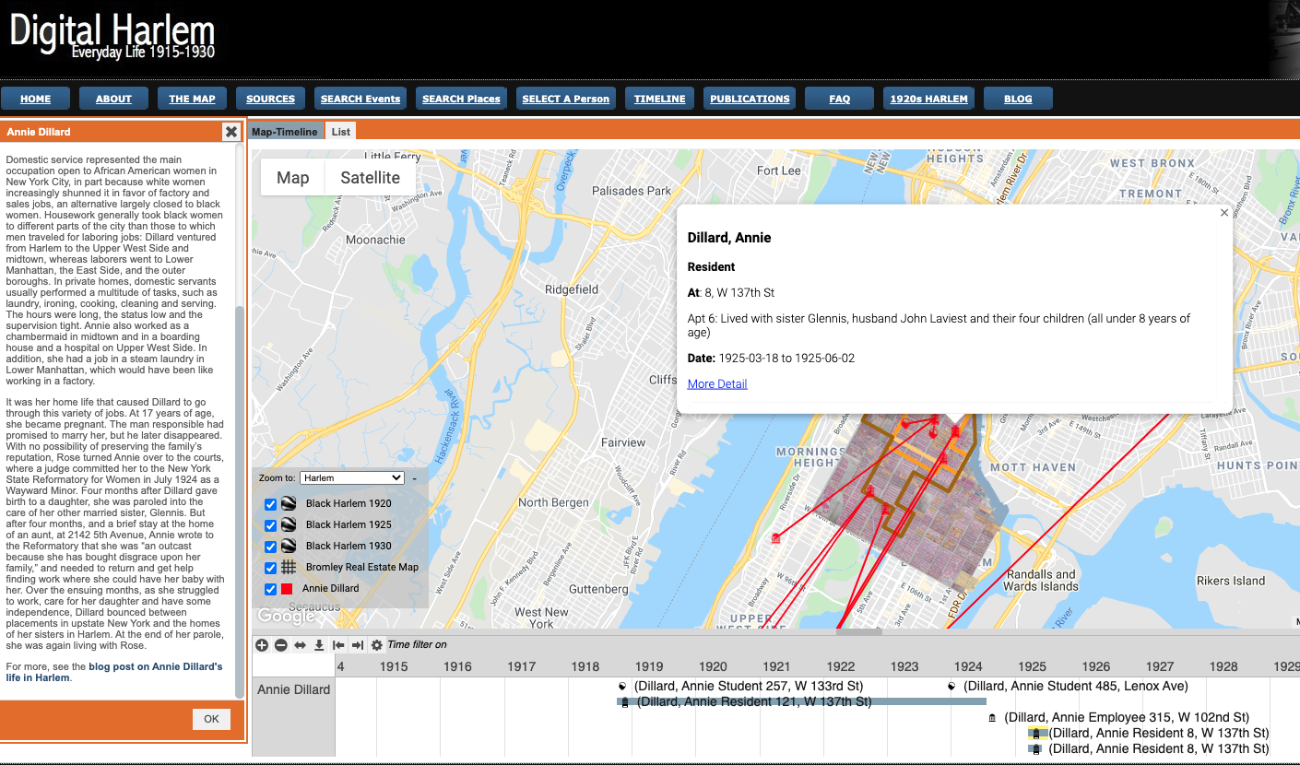
Sample DH Mapping Project - Digital Harlem

Slide 21
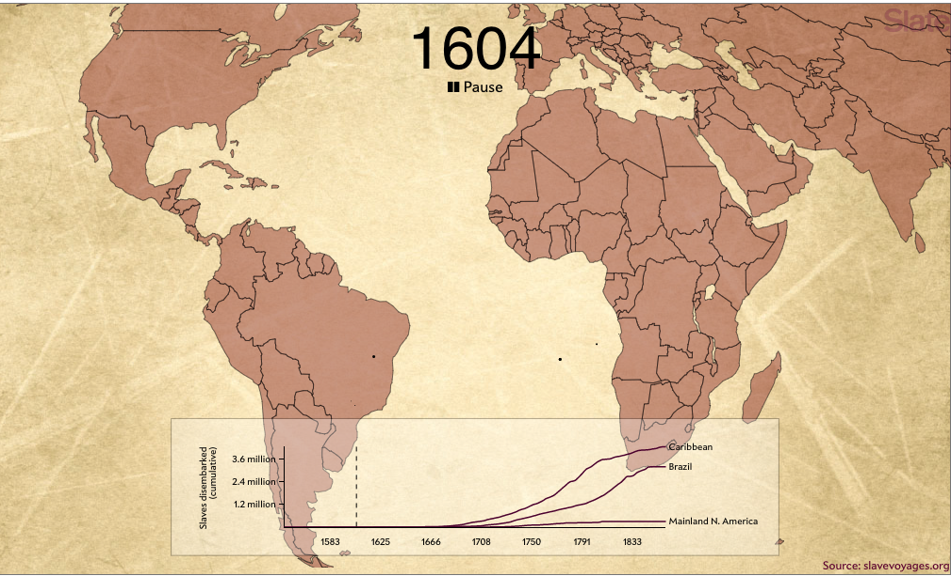
Sample DH Mapping Project - Slave Voyages
Notes:
The above map was comes from an article in Slate by Andrew Kahn and Jamelle Bouie. The map was created with the data from the Slave Voyages database.

